Slide 1
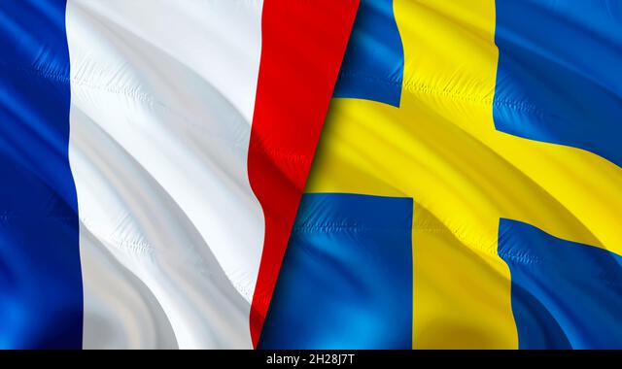
Introduction

Slide 2

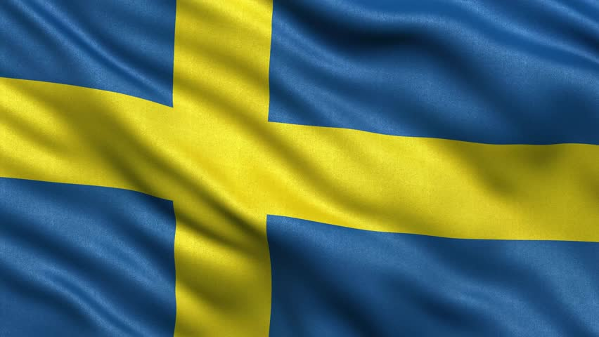
Openness & Transparency
Impatience
Queues
Equality
Formel & structured
Business culture
Forcefullness
Mixed messages
Personal integrity
Flat organisations structure
Time

Slide 3

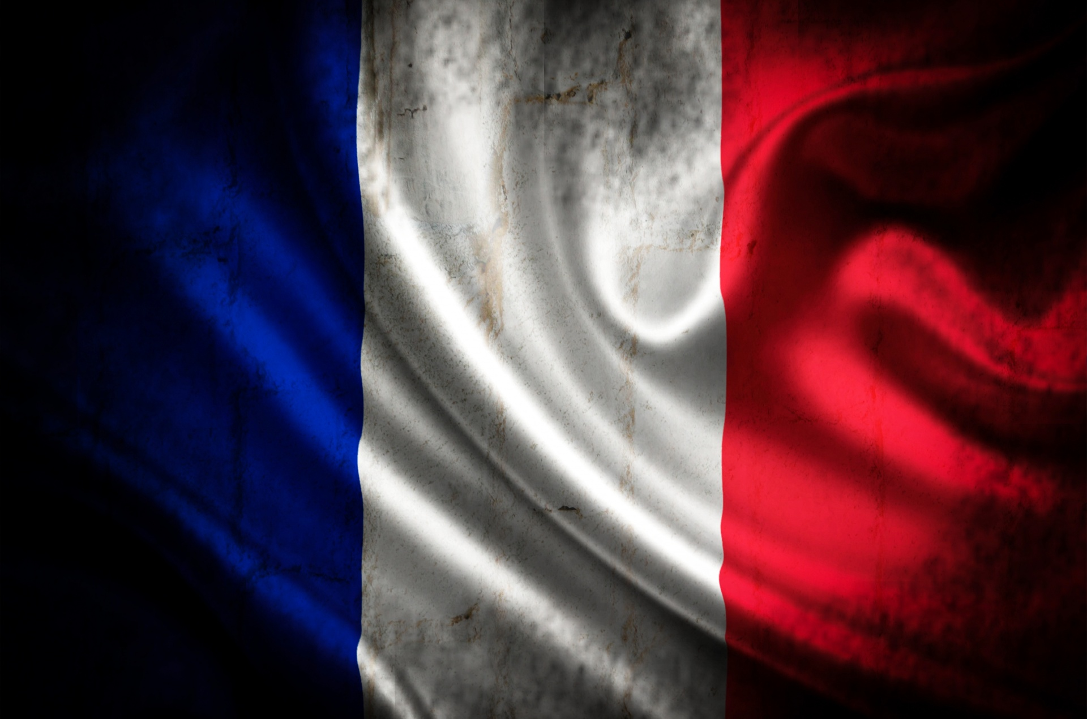
Respect to positions above
Language
Clear hierarchy
Business culture
Presentation
Proffesionel titles
Clothing
Build strong bands outside the work place

Slide 4


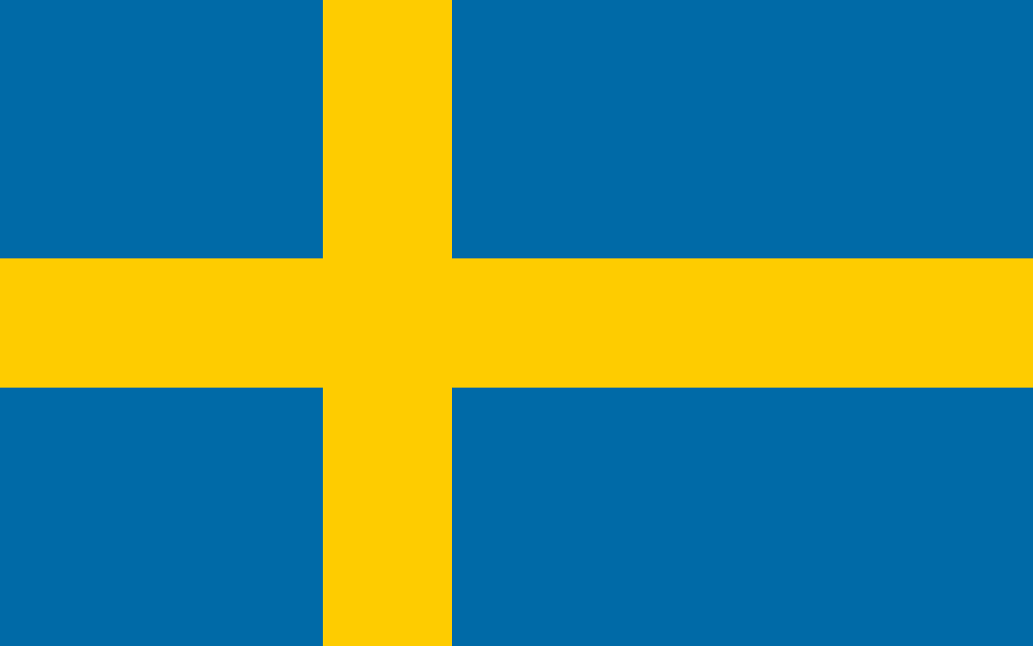
Trade statistics
68 milion people. Catholics, Muslims, Jews
Export/imports Germany, Belgium, Italy
671.5 billion SEK on imports
592.3 billion SEK on exports
-95.6 billion SEK deficit
Carrefour, Renault and L'Oréal.
10 milion people. Lutherans
Export/imports Germany, Norway, USA, UK, Denmark
182.6 billion SEK on imports
184.8 billion SEK on exports
2.2 billion SEK surplus
IKEA, Ericsson, Volvo Group, H&M,

Slide 5

Summary
Swedish and French business cultures have distinct characteristics, despite both being part of the European Union.
Overall, both Swedish and French business cultures have their unique strengths and are influenced by historical, societal, and economic factors. Understanding and respecting these cultural differences is essential for successful business interactions in each country.

